Slide 1
Is AI for you?
I explored at least 3 IT topics, and AI was one of them.
AI as a topic energized me and sparked my curiosity.
I can explain why I want to explore AI further.
I have created a professional product that an AI teacher validated.
I have researched the broader AI job market.
I have looked into Fontys ICT AI semesters and possibilities.

Slide 2
Some typical use cases of AI in industry.
How can AI help people get boring tasks done faster and more accurately?
How can we utilize AI for effective matchmaking (people and products)?
How can AI work with sensor data to find the best moment to act?
How can AI help with content creation?
How can AI help spot unusual activity in a system before it becomes a problem?
Notes:
The intention is to show cross-relations of AI and other fields. I am going to show you for these 5 questions very different product ideas, and also map them to two projects, building a Sports Software or controlling a greenhouse

Slide 3
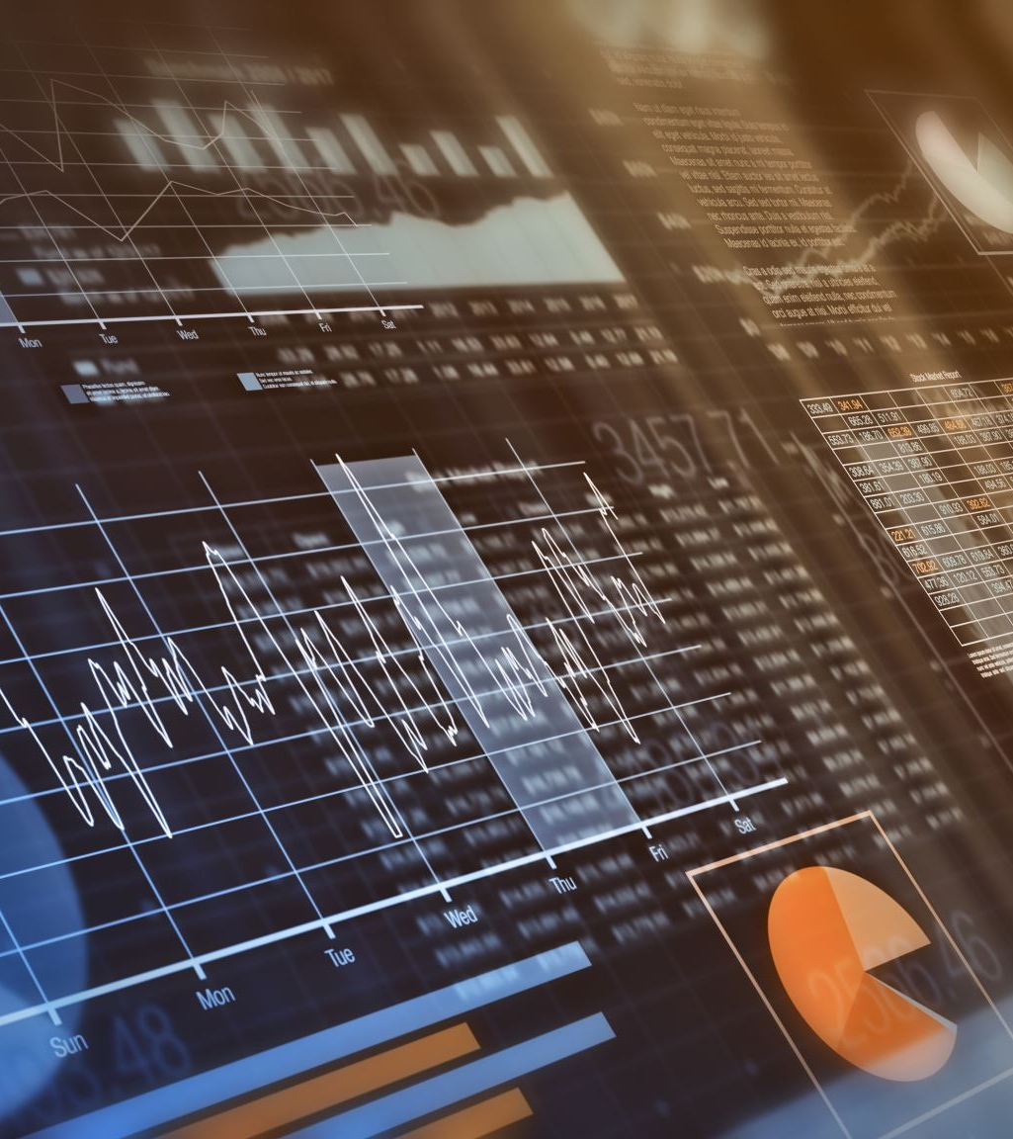
How can software robots help people get boring tasks done faster and more accurately?
Imagine a digital assistant that can automatically organize your emails, fill out forms, or track expenses for you.
AI can do these repetitive tasks so humans can focus on more interesting work.
What tasks around school, work, or home could you imagine automating this way?

Slide 4
You can ask the same questions for your project!
Question | Sports Software Example | Greenhouse Example
How can AI help people get boring tasks done faster and more accurately? | Help with scheduling sports practices, send customized feedback, or update messages | Automatically log sensor data, alert when water levels are low, or generate daily plant care reports.

Slide 5

How do online games decide which players should play together to keep matches fair and fun?
Think about Xbox or other multiplayer games—you rarely get stuck in a match with someone way too good or too new.
AI can help group players based on skill, play style, or connection quality, often using systems like matchmaking algorithms.

Slide 6
You can ask the same questions for your project!
Question | Sports Software Example | Greenhouse Example
How do online games decide which players should play together to keep matches fair and fun? | Suggest fair teams or matchups based on player skill, attendance, or engagement. | Suggest plant groupings for growth optimization (e.g., which plants thrive best together in microclimates).

Slide 7

How can devices like smartwatches or fitness bands make sense of the data they collect on their own?
Imagine a tiny device like a smartwatch that can recognize if you’re moving or resting.
TinyML lets small gadgets run simple AI tasks on their own, without needing to connect to the internet. What could this allow devices to do right where you are?

Slide 8
You can ask the same questions for your project!
Question | Sports Software Example | Greenhouse Example
How can devices like smartwatches or fitness bands make sense of the data they collect on their own? | AI suggests recovery days or personalized training plans by analyzing heart rate, sleep, or step data. | Smart sensors detect patterns in temperature, humidity, and soil moisture to optimize watering or ventilation.

Slide 9

How can AI change the look of a photo, video, or image to make it look like a painting, cartoon, or different artistic style?
Imagine taking a selfie and turning it into a Van Gogh–style painting or making a video look like a comic book.
Style transfer lets AI apply one visual style to another. What creative things could you make if you could change the style of any image or video instantly?

Slide 10
You can ask the same questions for your project!
Question | Sports Software Example | Greenhouse Example
What is style transfer in AI, and how is it used to transform images or media content? | Transform athlete photos for social posts (cartoon style, highlight moments). | Use style transfer to generate branded patterns for labels, seed packets, or staff apparel.

Slide 11

How can AI help spot unusual activity in a network or system before it becomes a problem?
Imagine your school Wi-Fi could notice if someone is trying to break in or if something strange happens online.
AI-based anomaly detection watches patterns in network traffic and flags anything unusual. How might this kind of “digital watchdog” keep systems safe?

Slide 12
You can ask the same questions for your project!
Question | Sports Software Example | Greenhouse Example
How can AI help spot unusual activity in a network or system before it becomes a problem? | Detect abnormal performance drops, unusual attendance patterns, or suspicious login activity in a sports app. | Detect sudden changes in plant environment or sensor anomalies before crops are damaged.

Slide 13
Choose one of the following challenges to work on today. You’ll design your AI solution.
How can AI help people get boring tasks done faster and more accurately?
How can AI help spot unusual activity in a system before it becomes a problem?
Notes:
The intention is to show cross-relations of AI and other fields.

Slide 14
Answer these questions to formulate your AI project
Phase | Guiding Questions | Example / Tip
Business Understanding | What problem are you solving? What does success look like? Who are the stakeholders and how will they use it? What are the ethical/compliance risks? | fewer conflicts, less manual work, staff satisfied, better yield or quality
Data Understanding | What data do you need? Are there existing datasets (Kaggle, sensors, logs)? Any data quality issues? | Attendance logs, player stats, heart rate, sleep; greenhouse: temp, humidity, soil moisture
Data Preparation | What features do you want to build? Do you need to clean, merge, or transform data? Any derived features? | Average attendance per week, aggregated sensor readings
Modeling | Which ML task fits best? (classification, regression, clustering, recommendation, anomaly detection) Which algorithms could help? | Decision trees, neural networks, basic regression/classification
Evaluation | How will you measure success? Would a pilot test or trial help? | Accuracy (precision and recall), time saved, stakeholder feedback
Deployment | How will your AI solution be used? Edge device, cloud app, or dashboard? How will stakeholders interact with it? | Example: App dashboard, alerts to staff, automated scheduling

Slide 15
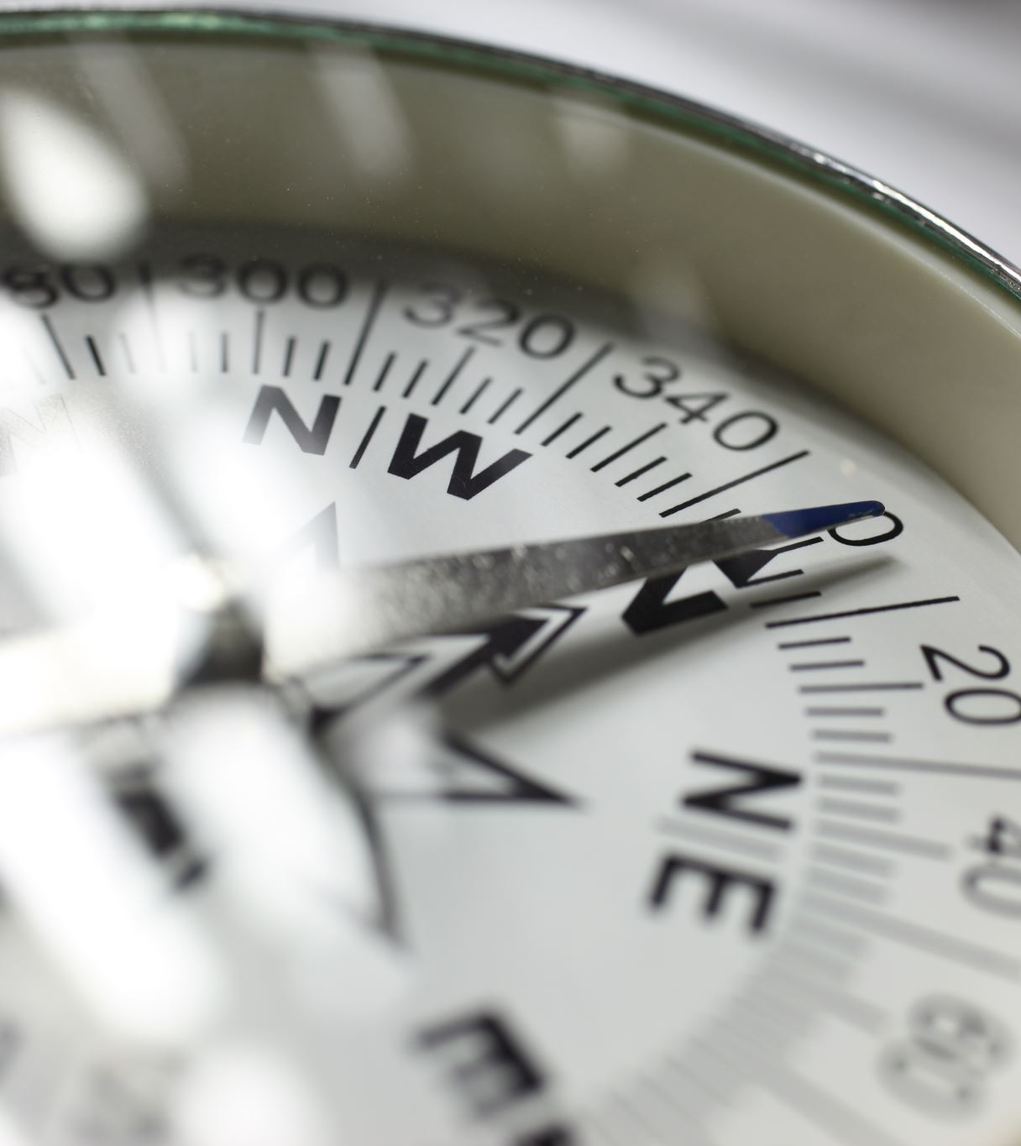
It is about orientation
For each application, ask:
Would this kind of work excite me?
What kind of company could involve this?
Does it match my personal values and goals?

Slide 16
Ask “Why” and “How” Beyond Definitions
Don’t stop at “what it is.” Ask:
Why is this useful?
How does it actually work in practice?
Example:
Instead of just reading “TinyML runs AI on devices,”
ask:
Why (and when) would running it locally be better than using the cloud?

Slide 17
How many of these statements are true for you?
I have looked into the Fontys ICT AI semesters.
I can describe the difference between AI, machine learning, data engineering, and data science in simple terms.
I have evaluated my personal interests and skills against AI-related tasks and challenges.
I have explored the ethical and societal implications of AI.
I can list AI roles, required skills, and potential career paths.
I can explain how AI could enhance or disrupt my chosen trade or industry.
I can articulate what excites me about AI and what concerns me.
I can decide whether pursuing AI further aligns with my personal and career goals.

